Slide 1


Resilience:
Are We Setting the Bar Too Low?
Denise Kay, PhD, MA, Associate Professor, Medical Education

Slide 2
30 Minute Focus
Focal Point =
Your experience of personal wellbeing
Go over some Buzz words and terminology
Present a conceptualization of ”stress” versus “distress” cascade
Personal Reflection
Evidence-Based interventions
Check-in Resources
Notes:
This information is for you! Though I may say “they” – in this case I’m referring to you
You are an executive – a problem solver.

Slide 3

Who am I?
Counseling & Educational Psychologist
8 Years of practice as Licensed Professional Counselor
Trained in Marriage & Family Therapy
Faculty Member since 2007
Been certified Personal Fitness Trainer
Program and Membership Director, YMCA
Developing a Resilient Health Care Work Force: A UCF Model for Academic Health Science Centers. Department of Health and Human Services Health Resources and Services Administration

Slide 4
Resilience
Resilience describes the phenomenon in which an individual does not, or only temporarily experiences mental health problems despite being subjected to psychological or physical stressors of short (acute) or long (chronic) duration. By definition,resilience presupposes the exposure to substantial risk or adversity.
Kunzler AM, Helmreich I, König J, Chmitorz A, Wessa M, Binder H, Lieb K. Psychological interventions to foster resilience in healthcare students. Cochrane Database of Systematic Reviews 2020, Issue 7. Art. No.: CD013684.DOI: 10.1002/14651858.CD013684.

Slide 5
Burnout
A syndrome characterized by ’deterioration of well-being’ and more precisely ’exhaustion’, ’weariness’ and ’negative attitude’ at the psychological level, and ’deterioration of well-being’ with presence of ’exhaustion’ at the physical level.
Guseva Canu, Irina et al. “Harmonized definition of occupational burnout: A systematic review, semantic analysis, and Delphi consensus in 29 countries.” Scandinavian journal of work, environment & health vol. 47,2 (2021): 95-107. doi:10.5271/sjweh.3935
Notes:
It is not yet possible to specify any symptom at the behavioral level. Importantly, in 12 of the 13 definitions, burnout is explicitly related to workplace.”
You can see from this definition of burnout we are not talking about a bad day, or even a bad week or disappointment at not meeting a quota or goal. It is a result long-term, pervasive exposure to stress. What is stress?

Slide 6
Occupational Stress
Negative environmental factors or stressors (e.g. work overload, role conflict/ambiguity, poor working conditions) associated with a particular job
Cooper, C.L. and Marshall, J. (1976). Occupational sources of stress: a review of the literature relating to coronary heart disease and mental ill-health. Journal of Occupational Psychology, 49, 11-28.
Notes:
Cooper, C.L. and Marshall, J. (1976). Occupational
sources of stress: a review of the literature relating
to coronary heart disease and mental ill-health.
Journal of Occupational Psychology, 49, 11-28.

Slide 7
Occupational Stress
Central Features of Work Stress
Dimensions of Characteristics of the Person
Sources of Stress in the Work Environment
Outside Relationship & Events
Cooper, C.L. and Marshall, J. (1976). Occupational sources of stress: a review of the literature relating to coronary heart disease and mental ill-health. Journal of Occupational Psychology, 49, 11-28.
Notes:
Outside relationships and events: family problems, financial difficulties, life crises (death in the family), etc., which have an impact in the workplace
Cooper, C.L. and Marshall, J. (1976). Occupational
sources of stress: a review of the literature relating
to coronary heart disease and mental ill-health.
Journal of Occupational Psychology, 49, 11-28.

Slide 8
Cascade to Distress
Notes:
Need to clarify the long-term, persistent experience of

Slide 9

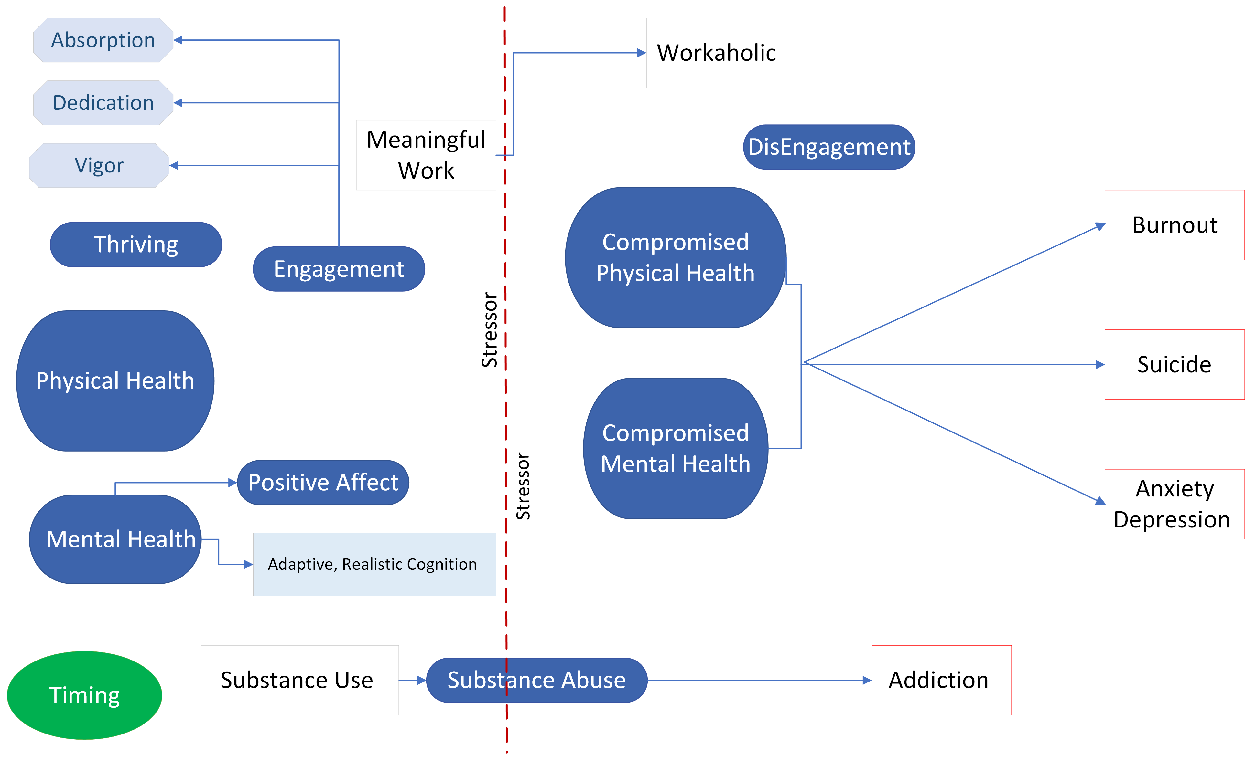
Thriving
Prevention
Eustress
Distress
Distress

Slide 10
Pause……Reflect
Perceived Stress Index
  Individual scores on the PSS can range from 0 to 40 with higher scores indicating higher perceived stress.
  ► Scores ranging from 0-13 would be considered low stress.
  ► Scores ranging from 14-26 would be considered moderate stress.
  ► Scores ranging from 27-40 would be considered high perceived stress.
The raw score ranges from 0 to 25
0 represents worst possible quality of life
25 represents best possible quality of life.
A score below 13 indicates poor wellbeing.
Share (anonymous)
WHO Well-being Index
Send text to: 37607
Text Message: denisekay566

Slide 11
Evidence-Based Interventions
STRESS
EXERCISE
NUTRITION
SLEEP
Cognitive Behavioral Therapy/Mindfulness
Acceptance Commitment Therapy
Emotional Freedom
Yoga
Psychological Detachment
Yoga
Physical Activity
Active Rest
Omega 3
Quality Sleep

Slide 12
STRESS
Psychological Detachment
Application
Mechanism
Conservation of Resources
Active process of resource acquisition and replenishment
Psychological Detachment requires:
involvement in activities un-related to the stressor or productivity demands
the absence of worry, rumination, or other repetitive thoughts about work (altering maladaptive thoughts).​
Psychological Detachment:
May be ‘doing nothing’
May require engagement in leisure activities
Effort Recovery
Effort expenditure at work leads to physiological and psychological load reactions (e.g., fatigue) that can be reversed when an individual stops working.
Karabinski, T., Haun, V. C., Nübold, A., Wendsche, J., & Wegge, J. (2021). Interventions for improving psychological detachment from work: A meta-analysis. Journal of Occupational Health Psychology, 26(3), 224–242. https://doi.org/10.1037/ocp0000280
Notes:
Psychological Detachment based on two recovery theories
Effort Recovery Theory and Conservation of Resources Theory
Think of load on a muscle, productivity as requiring energy, limited capacity to continue to work at high effectiveness or efficiency
Karabinski, T., Haun, V. C., Nübold, A., Wendsche, J., & Wegge, J. (2021). Interventions for improving psychological detachment from work: A meta-analysis. Journal of Occupational Health Psychology, 26(3), 224–242. https://doi.org/10.1037/ocp0000280
Put work in a box and play around it.
Need an interaction of something that is greater than work; the focus has to shift from what your mind is focusing on?
Intensity and duration; intense enough to get your mind to focus on it and/or long enough that you ‘let go’ of thoughts about work

Slide 13
Evidence-Based Interventions
STRESS
EXERCISE
NUTRITION
SLEEP
Cognitive Behavioral Therapy/Mindfulness
Acceptance Commitment Therapy
Emotional Freedom
Yoga
Psychological Detachment
Yoga
Physical Activity
Active Rest
Omega 3
Quality Sleep

Slide 14
Thriving
Prevention
Eustress
Distress
Distress

Slide 15
Flow
Characteristics of Flow
A state in which people are so involved in an activity that nothing else seems to matter; the experience is so enjoyable that people will continue to do it even at great cost, for the sheer sake of doing it
Complete concentration
Clarity of goals, reward and immediate feedback
Sense of time shifts
intrinsically rewarding
Effortlessness and ease
Balance between challenge and skills;
Not thinking about self
High sense of control over the task.
Notes:
Complete concentration on the task;
Clarity of goals and reward in mind and immediate feedback;
Transformation of time (speeding up/slowing down);
The experience is intrinsically rewarding;
Effortlessness and ease;
There is a balance between challenge and skills;
Actions and awareness are merged, losing self-conscious rumination;
There is a feeling of control over the task.

Slide 16
Work Engagement
A positive, fulfilling, work-related state of mind that is characterized by vigor, dedication, and absorption.
Work engagement is negatively related to burnout
Michishita, Jiang, Y., Ariyoshi, D., Yoshida, M., Moriyama, H., Obata, Y., Nagata, M., Nagata, T., Mori, K., & Yamato, H. (2017). The Introduction of an Active Rest Program by Workplace Units Improved the Workplace Vigor and Presenteeism Among Workers: A Randomized Controlled Trial. Journal of Occupational and Environmental Medicine, 59(12), 1140–1147. https://doi.org/10.1097/JOM.0000000000001121
Notes:
Michishita, Jiang, Y., Ariyoshi, D., Yoshida, M., Moriyama, H., Obata, Y., Nagata, M., Nagata, T., Mori, K., & Yamato, H. (2017). The Introduction of an Active Rest Program by Workplace Units Improved the Workplace Vigor and Presenteeism Among Workers: A Randomized Controlled Trial. Journal of Occupational and Environmental Medicine, 59(12), 1140–1147. https://doi.org/10.1097/JOM.0000000000001121

Slide 17
Evidence-Based Interventions
STRESS
EXERCISE
NUTRITION
SLEEP
Cognitive Behavioral Therapy/Mindfulness
Acceptance Commitment Therapy
Emotional Freedom
Yoga
Psychological Detachment
Yoga
Physical Activity
Active Rest
Omega 3
Quality Sleep

Slide 18
Active Rest
Presenteeism
decreased on-the-job performance due to the presence of health problems
Active Rest
moderate exercise allows individuals to recover from fatigue more effectively than passive rest
Work Functioning Impairment
the degree to which the ability to function at work is
impaired by health problems
Schultz, & Edington, D. W. (2007). Employee health and presenteeism: a systematic review. Journal of Occupational Rehabilitation, 17(3), 547–579. https://doi.org/10.1007/s10926-007-9096-x
Michishita, Jiang, Y., Ariyoshi, D., Yoshida, M., Moriyama, H., Obata, Y., Nagata, M., Nagata, T., Mori, K., & Yamato, H. (2017). The Introduction of an Active Rest Program by Workplace Units Improved the Workplace Vigor and Presenteeism Among Workers: A Randomized Controlled Trial. Journal of Occupational and Environmental Medicine, 59(12), 1140–1147. https://doi.org/10.1097/JOM.0000000000001121
Notes:
Schultz, & Edington, D. W. (2007). Employee health and presenteeism: a systematic review. Journal of Occupational Rehabilitation, 17(3), 547–579. https://doi.org/10.1007/s10926-007-9096-x
Michishita, Jiang, Y., Ariyoshi, D., Yoshida, M., Moriyama, H., Obata, Y., Nagata, M., Nagata, T., Mori, K., & Yamato, H. (2017). The Introduction of an Active Rest Program by Workplace Units Improved the Workplace Vigor and Presenteeism Among Workers: A Randomized Controlled Trial. Journal of Occupational and Environmental Medicine, 59(12), 1140–1147. https://doi.org/10.1097/JOM.0000000000001121

Slide 19
Active Rest
Protocol
Participants performed:
a 10-minute lunch fitness program
3 times per week for 10 weeks (29 times).
This short-time exercise program consisted of:
warm-up - stretching
cognitive functional training
aerobic exercise
body weight resistance training
cool-down components.
Michishita, Jiang, Y., Ariyoshi, D., Yoshida, M., Moriyama, H., Obata, Y., Nagata, M., Nagata, T., Mori, K., & Yamato, H. (2017). The Introduction of an Active Rest Program by Workplace Units Improved the Workplace Vigor and Presenteeism Among Workers: A Randomized Controlled Trial. Journal of Occupational and Environmental Medicine, 59(12), 1140–1147. https://doi.org/10.1097/JOM.0000000000001121
Notes:
Michishita, Jiang, Y., Ariyoshi, D., Yoshida, M., Moriyama, H., Obata, Y., Nagata, M., Nagata, T., Mori, K., & Yamato, H. (2017). The Introduction of an Active Rest Program by Workplace Units Improved the Workplace Vigor and Presenteeism Among Workers: A Randomized Controlled Trial. Journal of Occupational and Environmental Medicine, 59(12), 1140–1147. https://doi.org/10.1097/JOM.0000000000001121

Slide 20
Active Rest
Results
Significant improvement
Time spent in moderate to vigorous activity
Vigor-activity
Worthwhileness of working life
Satisfaction with job/daily life
Friendliness
Support from superiors
Colleagues and family/friends
Interpersonal Stress
Physical complaints
Fatigue-inertia
Work Functioning Impairment
Significant decrease
Michishita, Jiang, Y., Ariyoshi, D., Yoshida, M., Moriyama, H., Obata, Y., Nagata, M., Nagata, T., Mori, K., & Yamato, H. (2017). The Introduction of an Active Rest Program by Workplace Units Improved the Workplace Vigor and Presenteeism Among Workers: A Randomized Controlled Trial. Journal of Occupational and Environmental Medicine, 59(12), 1140–1147. https://doi.org/10.1097/JOM.0000000000001121
Ryoma Michishita, Ying Jiang, Daisuke Ariyoshi, Marie Yoshida, Hideko Moriyama, & Hiroshi Yamato. (2017). The practice of active rest by workplace units improves personal relationships, mental health, and physical activity among workers. Journal of Occupational Health, 59(2), 122–130.
Notes:
Michishita, Jiang, Y., Ariyoshi, D., Yoshida, M., Moriyama, H., Obata, Y., Nagata, M., Nagata, T., Mori, K., & Yamato, H. (2017). The Introduction of an Active Rest Program by Workplace Units Improved the Workplace Vigor and Presenteeism Among Workers: A Randomized Controlled Trial. Journal of Occupational and Environmental Medicine, 59(12), 1140–1147. https://doi.org/10.1097/JOM.0000000000001121
Ryoma Michishita, Ying Jiang, Daisuke Ariyoshi, Marie Yoshida, Hideko Moriyama, & Hiroshi Yamato. (2017). The practice of active rest by workplace units improves personal relationships, mental health, and physical activity among workers. Journal of Occupational Health, 59(2), 122–130.
Across the two studies, Significant improvement or decreases between intervention and control group

Slide 21
Evidence-Based Interventions
STRESS
EXERCISE
NUTRITION
SLEEP
Cognitive Behavioral Therapy/Mindfulness
Acceptance Commitment Therapy
Emotional Freedom
Yoga
Psychological Detachment
Yoga
Physical Activity
Active Rest
Omega 3
Quality Sleep

Slide 22
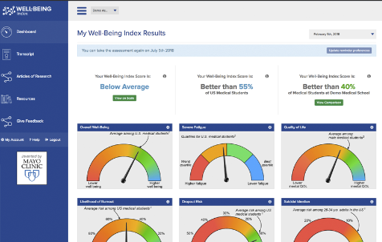
Wellness check?
https://www.mywellbeingindex.org/
Notes:
https://app.mywellbeingindex.org/login

Slide 23
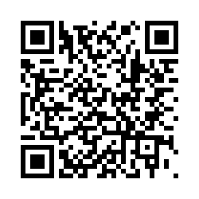
Developing a Resilient Health Care Work Force: A UCF Model for Academic Health Science Centers. Department of Health and Human Services Health Resources and Services Administration
Survey of Health Professional Students and Practitioner Perceived Stress Levels and Stress Management Tools
Attention health professions’ students and clinicians, we invite you to take a short ~15 minute survey to assess your stress levels and stress management practices which will greatly benefit medical training programs.
Scan QR code below to access the survey
Denise.kay@ucf.edu

Slide 24
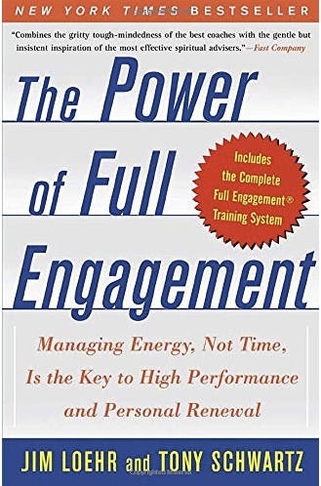
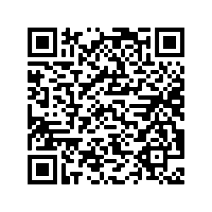
STRESS
Psychological Detachment
Free energy profile
https://performanceprograms.com/self-assessments/personal-development/energy-profile/
Notes:
https://performanceprograms.com/self-assessments/personal-development/energy-profile/
2003

Slide 25

Thank you!
Denise.kay@ucf.edu
Notes:
Website and future resources for health professionals

Slide 26
NUTRITION
Omega 3 Fatty Acids
Polyunsaturated Fatty Acids (PUFAs)
Mechanism
DHA
EPA
Decreases inflammation
Protects neurons
Inhibits the para inflammatory cascade implicated in the pathogenesis of depression
Inhibits the hyperactivation of the hypothalamic-pituitary-adrenal axis
Improves omega 3 FA in the brain
Liao, Y., Xie, B., Zhang, H. et al. Efficacy of omega-3 PUFAs in depression: A meta-analysis. Transl Psychiatry 9, 190 (2019). https://doi.org/10.1038/s41398-019-0515-5
Giuseppe Grosso, Agnieszka Micek, Stefano Marventano, Sabrina Castellano, Antonio Mistretta, Andrzej Pajak, Fabio Galvano,​ Dietary n-3 PUFA, fish consumption and depression: A systematic review and meta-analysis of observational studies,​ Journal of Affective Disorders,​ Volume 205, 2016,Pages 269-281,ISSN 0165-0327,​ https://doi.org/10.1016/j.jad.2016.08.011.
Notes:
DDecreases inflammation Protects neurons ( increases N-acetyl-aspartate, increases phospholipid turnover to decrease brain atrophy, increases brain-derived neurotrophic factor)
Inhibits the para inflammatory cascade implicated in the pathogenesis of depression (binds PPARg to regulate the expression of Nf-Kb)
Inhibits the hyperactivation of the hypothalamic-pituitary-adrenal axis (attenuates PG E2activation of IL6 and decreases CRH)
Improves omega 3 FA in the brain (related to anxiety behaviors)
ecrease inflammation

Slide 27
NUTRITION
Omega 3 Fatty Acids
Polyunsaturated Fatty Acids (PUFAs)
Where can you get Omega 3FA EPA/DHA?
Fatty fish (mackerel, sardines, Alaskan sockeye salmon, fish roe, and krill oil)
Plant sources of omega 3FA (flax and chia seeds) contain primarily APA, which is converted into EPA and DHA at very low levels, so not an optimal source
DHA+EPA supplements
Norwitz, Nicholas G., and Uma Naidoo. "Nutrition as Metabolic Treatment for Anxiety." Perspective, Frontiers in Psychiatry 12 (2021-February-12 2021). https://dx.doi.org/10.3389/fpsyt.2021.598119.

Slide 28
NUTRITION
Omega 3 Fatty Acids
Polyunsaturated Fatty Acids (PUFAs)
Application
Anxiety
Depression
At least 2g/day of EPA/DHA<60%​​
The biggest effect was with an EPA dose of 720mg/day-1000mg/day and EPA/DHA >60%​
Both fish and omega 3 FA supplementation
improve depression symptoms
Optimal effect for fish = 50g/day​
Optimal effect for EPA+DHA = 0.6g/day
Liao, Y., Xie, B., Zhang, H. et al. Efficacy of omega-3 PUFAs in depression: A meta-analysis. Transl Psychiatry 9, 190 (2019). https://doi.org/10.1038/s41398-019-0515-5.
Su K, Tseng P, Lin P, et al. Association of Use of Omega-3 Polyunsaturated Fatty Acids With Changes in Severity of Anxiety Symptoms: A Systematic Review and Meta-analysis. JAMA Netw Open. 2018;1(5):e182327. doi:10.1001/jamanetworkopen.2018.2327​​
Notes:
supplementation improves sypmtoms of anxiety​ and depression
EPA
DHA is best
EPA and DHA go together in supplements
Studies show that anxiety EPA has best effect DHA per EPA less than 60^

Slide 29
SLEEP
Getting enough quality sleep protects:
mental health,
physical health
quality of life
safety

Slide 30
SLEEP
  Sleep deficits can lead to:
  trouble making decisions
  solving problems
  controlling emotion and behavior
  coping with change
  depression
  suicide
  risk-taking behavior.
Notes:
Ongoing sleep deficiency is linked to an increased risk of heart disease, kidney disease, high blood pressure, diabetes, and stroke.

Slide 31
SLEEP and Burnout: Are they related?
Models describing the relation between burnout and sleep suggest potential causative mechanisms of sleep disturbances as:
a chronic depletion of energy stores
activation of the hypo-thalamic-pituitary-adrenal axis and increasing levels of bodily stress
Sleep and Burnout – Are they Related?
Stewart NH, Arora VM. The Impact of Sleep and Circadian Disorders on Physician Burnout. Chest. 2019 Nov;156(5):1022-1030. doi: 10.1016/j.chest.2019.07.008. Epub 2019 Jul 25. PMID: 31352036; PMCID: PMC6859241.
Notes:
Please provide complete reference

Slide 32

SLEEP
Exercise daily
Develop evening rituals
Build in wind down time and a relaxing bedtime routine
Maintain a consistent sleep schedule – even on weekends
Build your nest – sleep space should be cool and free of sound and light disturbances
Screen time before bed
alcohol in the evenings
large meals 2-3 hours before bedtime
CDC, 2016

Slide 33
Structured Napping Intervention
  Examined the potential benefit of 20-minute structured naps compared to biofeedback and wellness as usual (control) with pre-clinical medical students.​
    Found that students who were assigned to take three 20-minute naps per week reported lower stress and burnout compared to other groups.​
    Was positively correlated with stress management
    Physician Wellbeing measure was better for those in intervention combined (either napping or biofeedback) compared to control (wellness as usual) at post-test. ​
Hernandez C, Daly K, Mehta A et al. A Pilot Study Examining Biofeedback and Structured Napping to Promote Medical Student Wellbeing [version 1]. MedEdPublish 2019, 8:110 (https://doi.org/10.15694/mep.2019.000110.1)
Notes:
Please add any quantification or results , p value, etc…

Slide 34
Acceptance & Commitment Therapy ACT
ACT:
a third-generation Cognitive Behavioral Therapy (CBT).
uses a range of therapeutic methods to help individuals to improve their “psychological flexibility”
Psychological Flexibility:
defined as: “the ability to persist or to change behavior in a setting of competing psychological influences, guided by values and goals dependent on what the situation at hand affords” (McCracken, 2013, p.828).
3 sub-components:
Openness, which involves showing willingness to have unwanted thoughts and feelings,
Awareness, the ability to mindfully notice one’s experiences as they occur in the here-and-now, and
Engagement, consistently choosing actions that enable progress on one’s overarching goals and values.
McCracken LM. Committed action: an application of the psychological flexibility model to activity patterns in chronic pain. J Pain.
2013 Aug;14(8):828-35. doi: 10.1016/j.jpain.2013.02.009.
Epub 2013 May 4. PMID: 23651881.

Slide 35
Intervention 3: Emotional Freedom
Emotional freedom is a self-administered technique that combines elements of cognitive restructuring and exposure techniques with an active component of acupoint stimulation (tapping).
Church, D., Stapleton, P., Yang, A., Gallo, F. (2018) Is Tapping on Acupuncture Points an Active Ingredient in Emotional Freedom Techniques? A Systematic Review and Meta-analysis of Comparative Studies, The Journal of Nervous and Mental Disease: 206:10, p.783-793. doi: 10.1097/NMD.0000000000000878

Slide 36
STRESS
Psychological Detachment
Notes:
https://performanceprograms.com/self-assessments/personal-development/energy-profile/
2003

